Slide 1
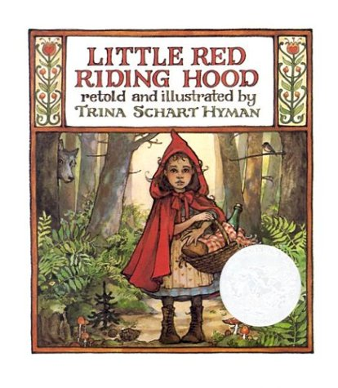
Comparing and Contrasting
Character’s Adventures
Part 3
Mrs. Talley’s Kindergarten
Russell Jones Elementary
February 23, 2012

Slide 2
Mrs. Talley and Mrs. Hensley continued working with the standard and activity from the previous days’ lessons.
RL.K.9 With prompting and support, compare and contrast the adventures and experiences of characters in familiar stories.

Slide 3
This lesson focused on comparing the “adventures” in two stories.
RL.K.9 With prompting and support, compare and contrast the adventures and experiences of characters in familiar stories.

Slide 4
Because many of Mrs. Talley’s students are language learners, this lesson was planned to incorporate the
following language objectives:
Language Objectives:
Listening: Listen to literature from diverse cultures and respond appropriately using one or two word phrases (e.g., retelling, dramatizing) (ELPL.1.K-2.8)
Speaking: Respond appropriately- EL1 one or two word phrases, EL2 simple sentences (ELPL.1.K-2.8)
Reading: Answer questions (ELPR.4.K-2.4)
Writing: Apply strategies, when prompted, to move from oral
to written language (ELPW.7.K-2.4)

Slide 5
(2) Identifying Similarities and Differences
(7) Cooperative Learning
(8) Setting Objectives and Providing Feedback
(3) Summarizing and Note Taking
(4) Reinforcing Effort and Providing Recognition
(9) Generating and Testing Hypotheses
(5) Homework and Practice
(10) Cues, Questions and Advance Organizers
(6) Nonlinguistic Representations
GANAG gives students the opportunity to actively use the nine high-yield strategies.

Slide 6
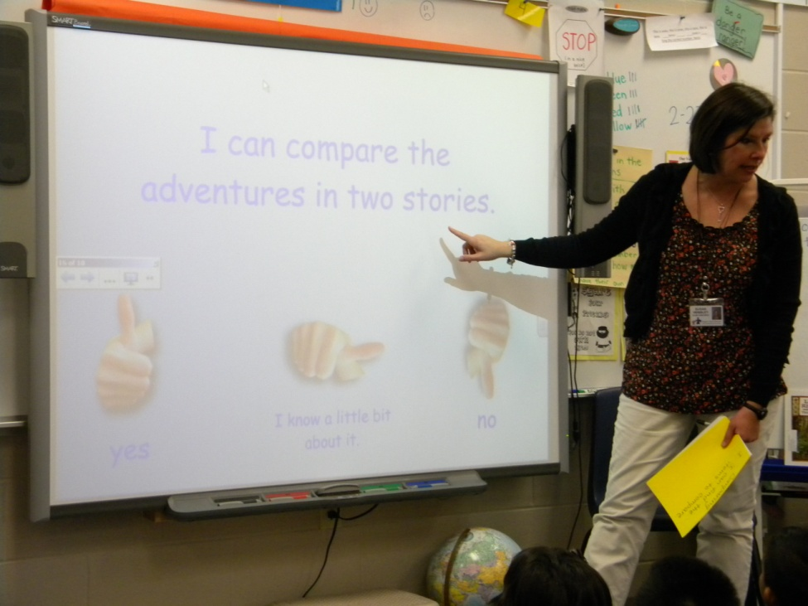
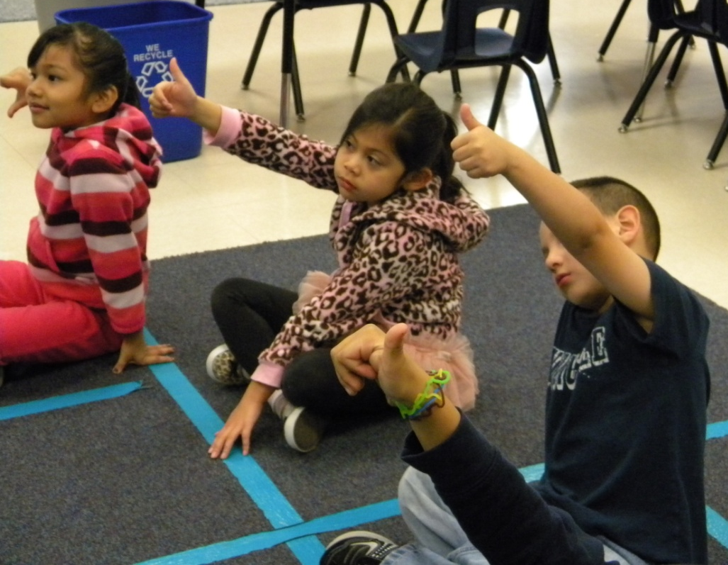
Goal:
I can compare the adventures in two stories.
Students scored themselves to the goal with a thumbs up or down.
(8) Setting Objectives and Providing Feedback

Slide 7
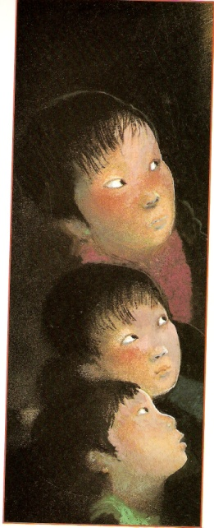
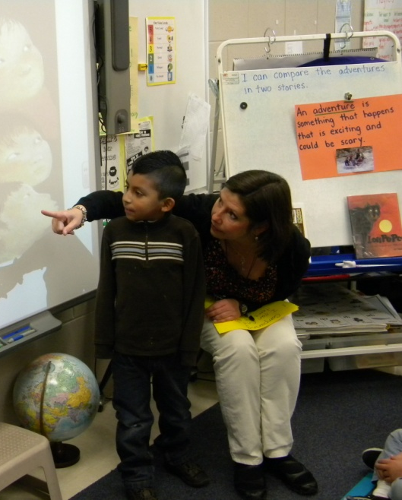
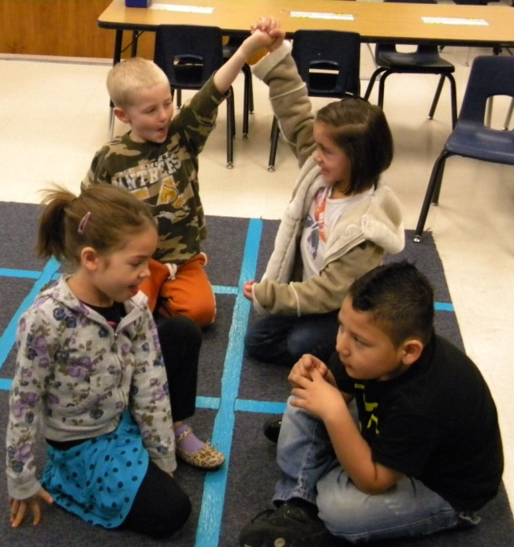
Access Prior Knowledge
“Look at these two pictures. How are they the same?”
A student helped Ms. Hensley model talking with a partner and then making a partner pyramid.
Partners shared their responses.
(7) Cooperative Learning
(10) Cues, Questions and Advance Organizers

Slide 8
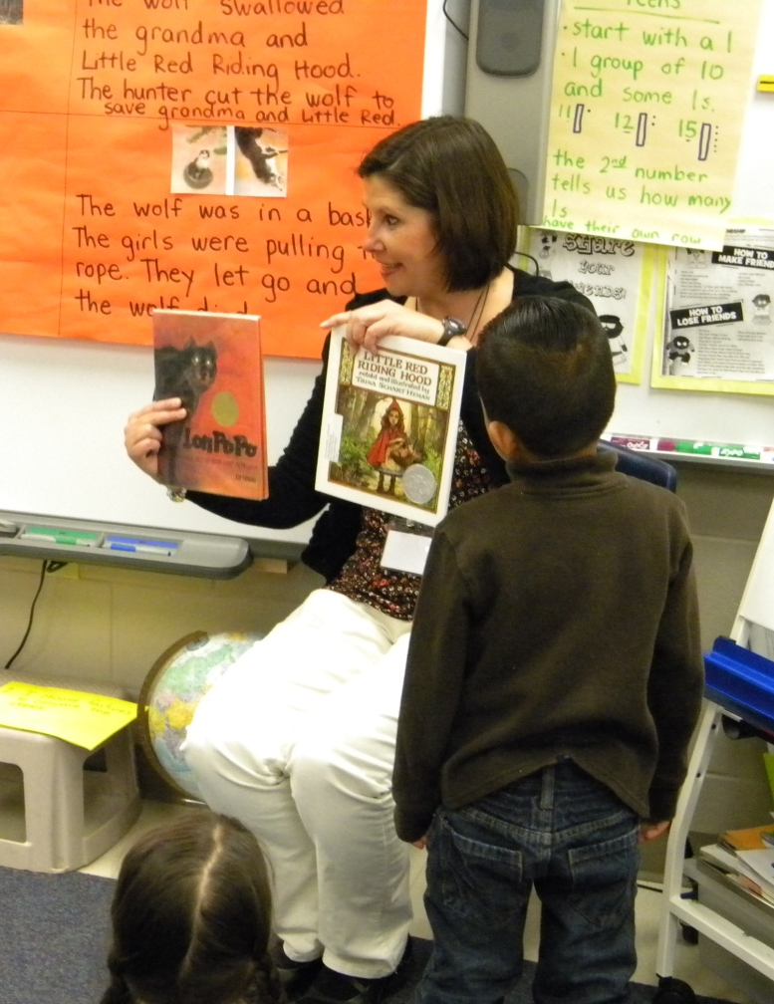
New Information
“Today our goal is to compare the adventures of two stories.”
“There are three steps we need to follow when we want to compare.”
I can find the items to compare.
“What are we going to compare today?”
(2) Identifying Similarities and Differences

Slide 9
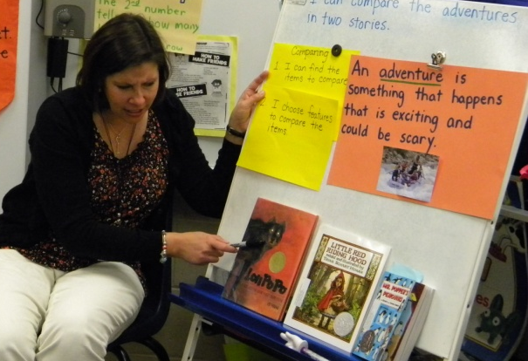
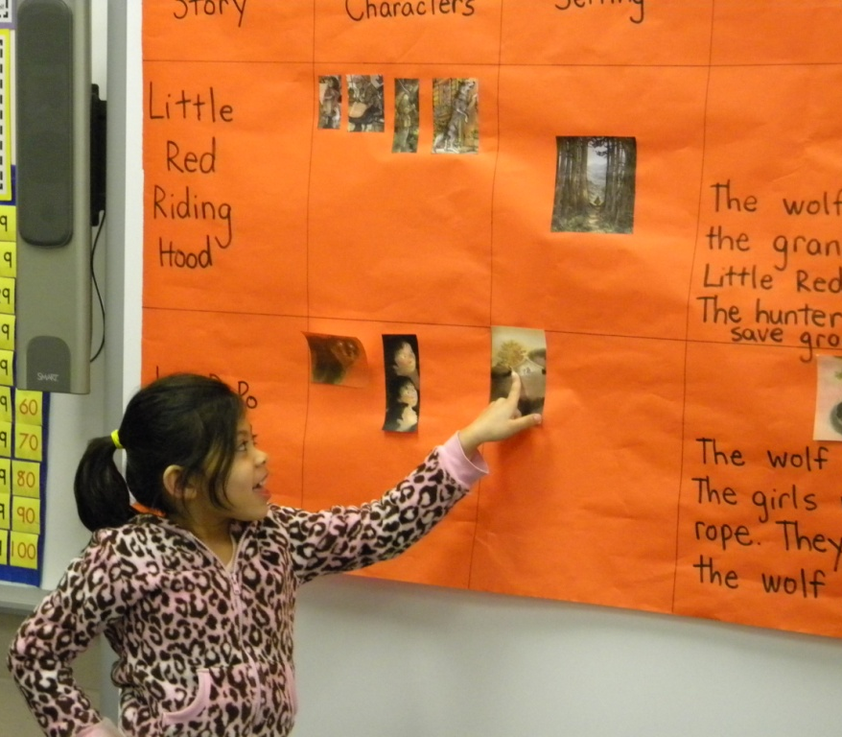
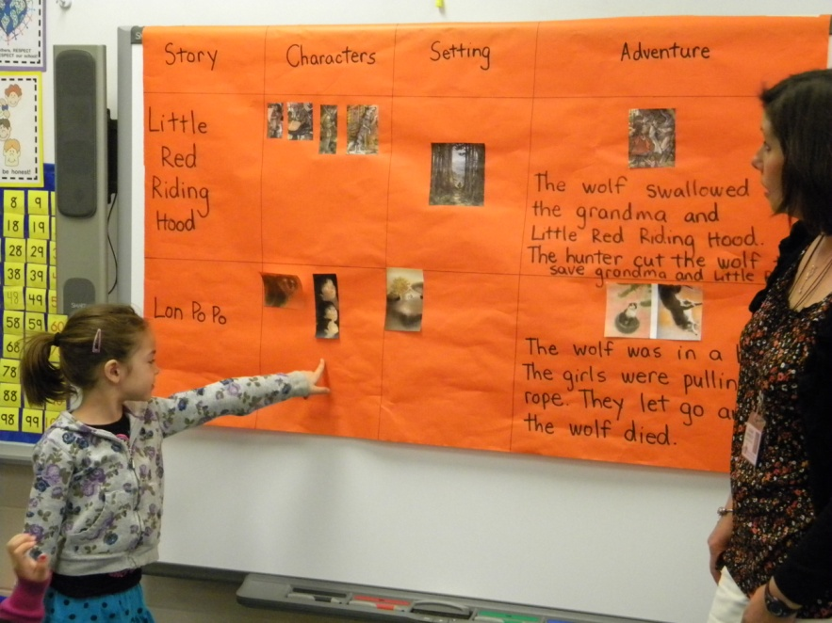
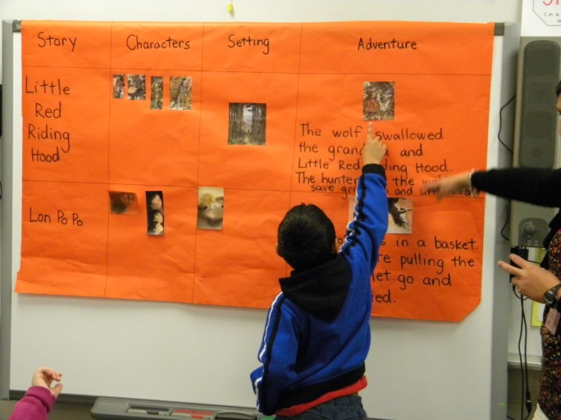
I can find the items to compare.
2. I can choose the features to compare.
With prompting and support, the students identified the “features” of the matrix from the previous lessons.
characters
setting
adventure

Slide 10
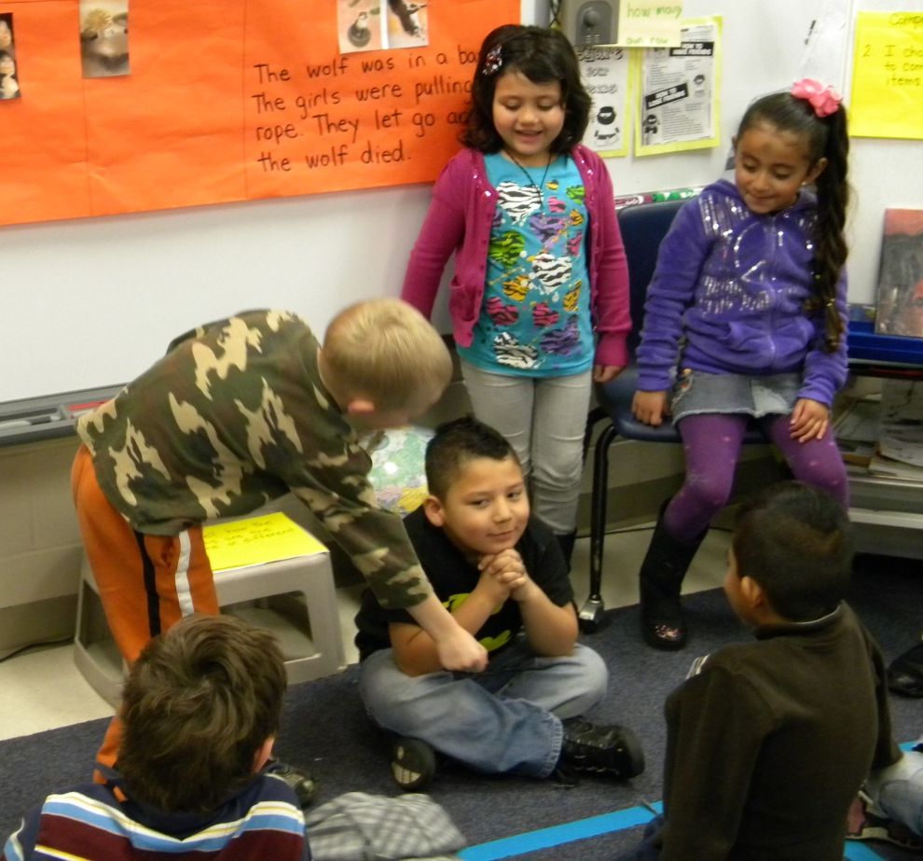
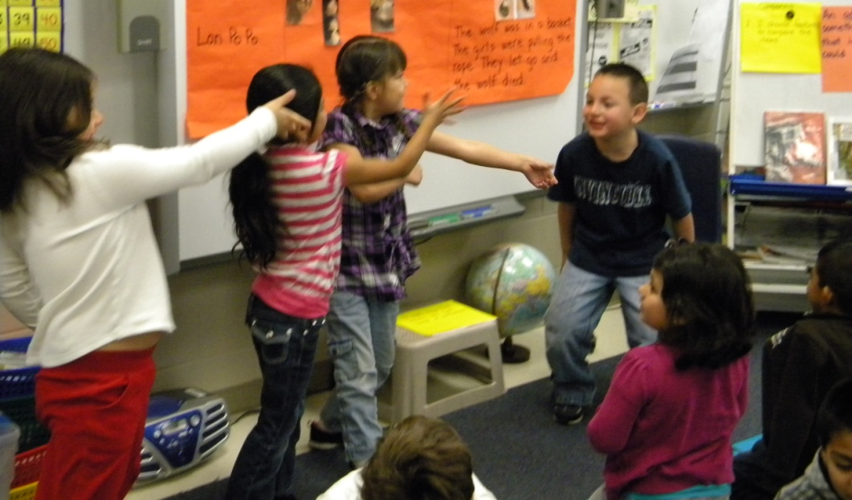
After identifying “adventure” as the feature to compare, students acted out the adventure from each story.
Little Red Riding Hood
The huntsman cut the wolf open to rescue Little Red Riding Hood and her grandma.
Lon Po Po
The sisters use all their strength to pull the wolf up before dropping him.
(6) Nonlinguistic Representations

Slide 11
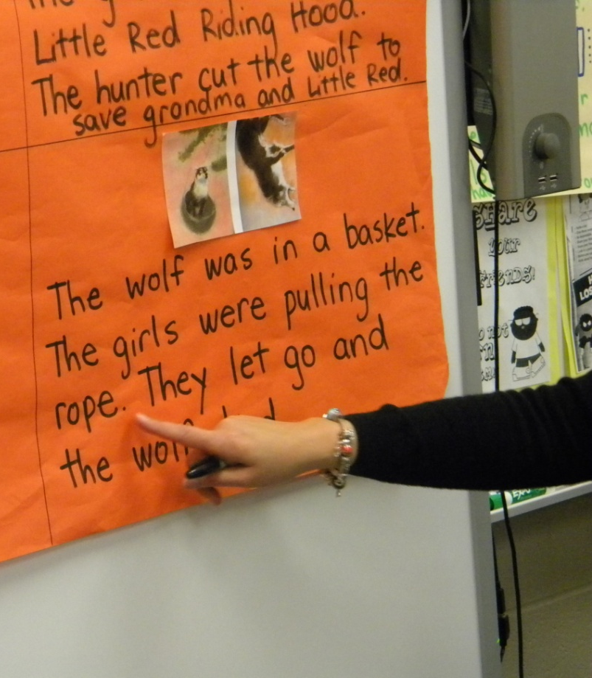
I can find the items to compare.
2. I can choose the features to compare.
3. I can tell how the items are the same or different.
“How are the adventures in these two stories the same?”
Students shared their ideas.

Slide 12
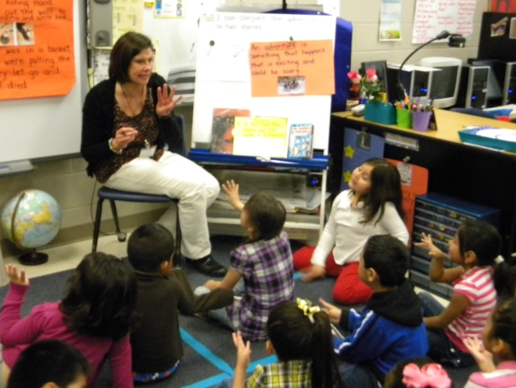
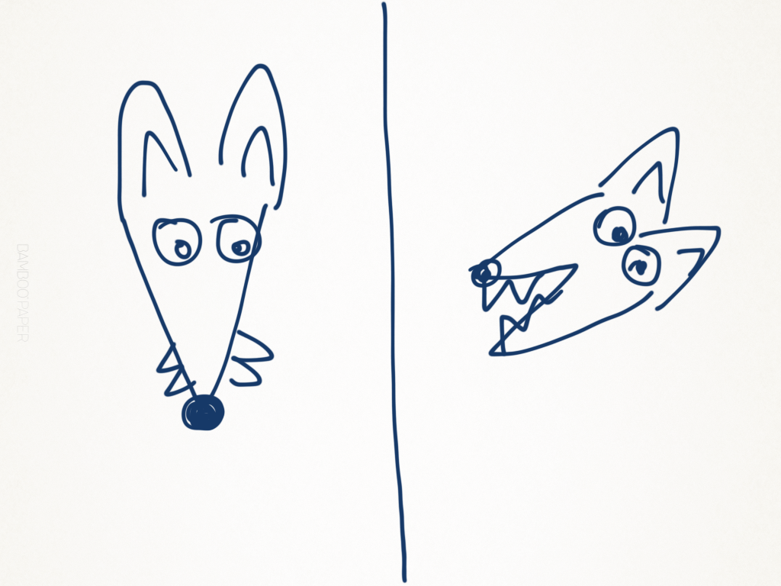
Ms. Hensley modeled thinking about how the adventures were the same. Then she modeled writing about her ideas.
The wolves in both stories had big teeth. They both wanted to eat someone.

Slide 13
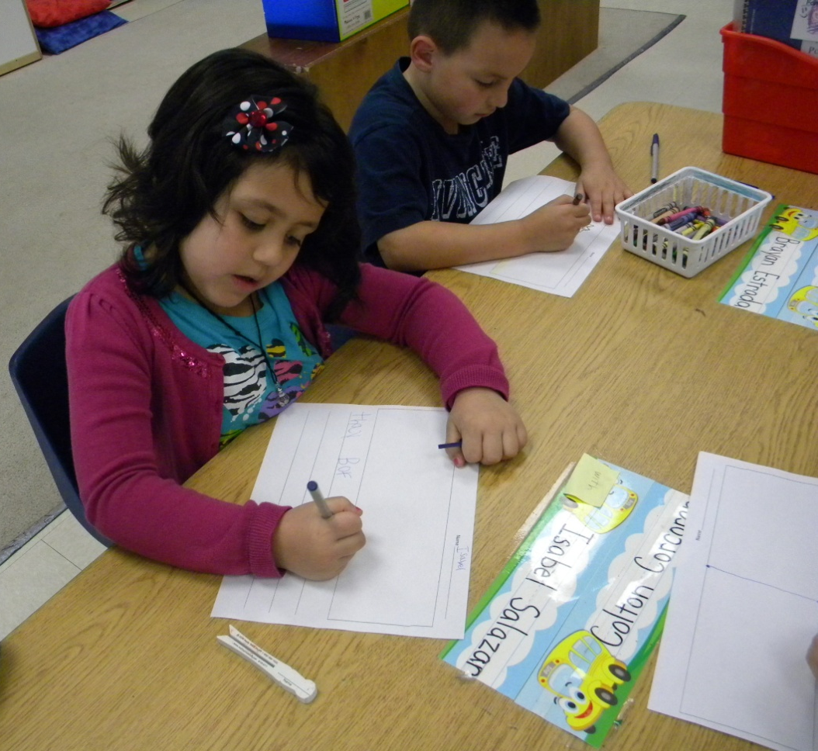
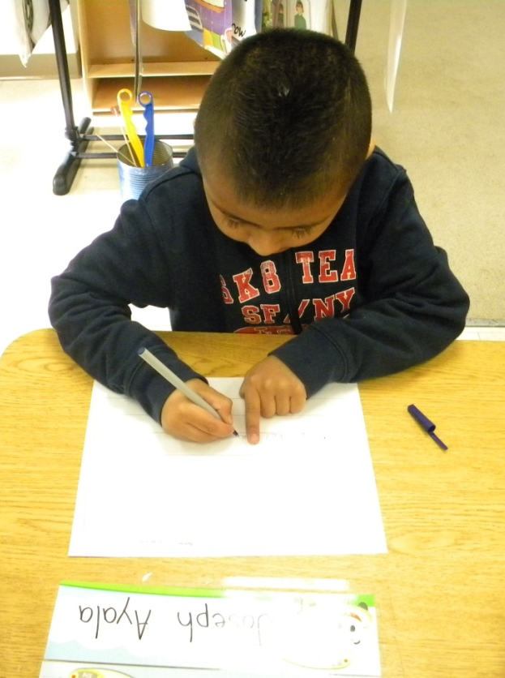
Application
Students wrote about how the character’s adventures in both stories were the same.
(5) Homework and Practice

Slide 14
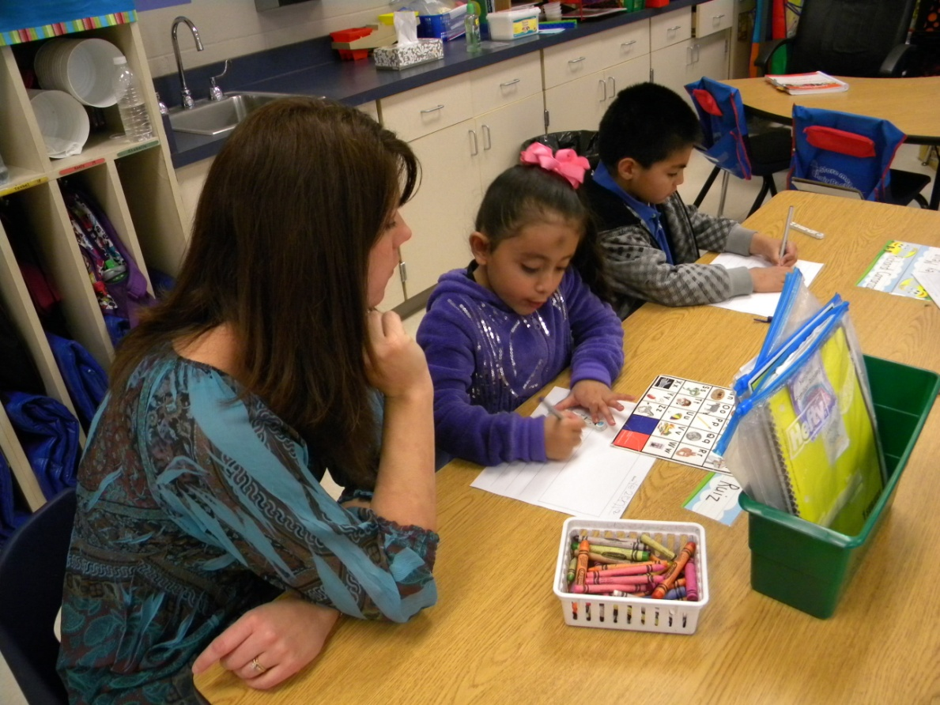
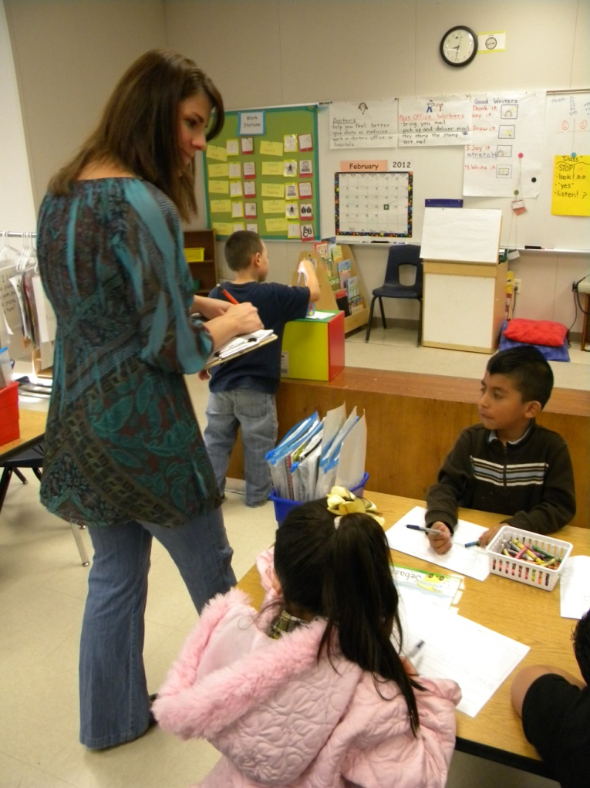
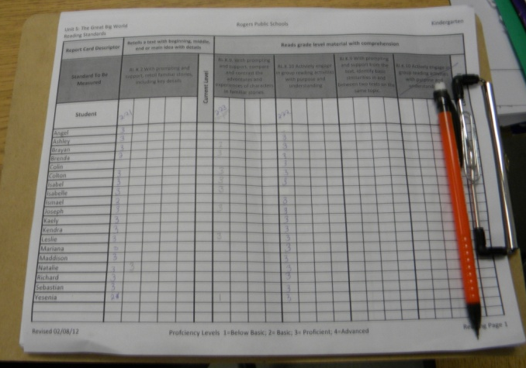
Mrs. Talley scored students performance of the standard using a clipboard and scoring guide.

Slide 15
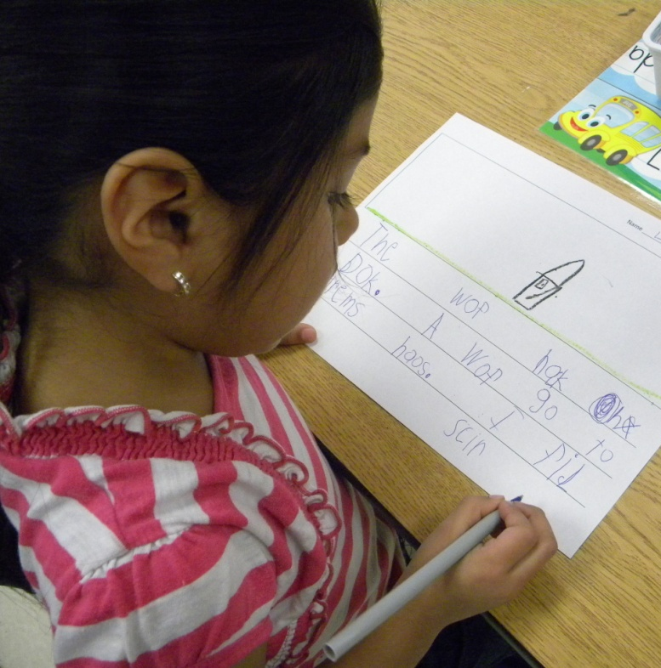
Ms. Hensley and Mrs. Talley selected students to share their writing.
The wolf knock on the door. A wolf go to grandmas house. I felt scared.
(4) Reinforcing Effort and Providing Recognition

Slide 16
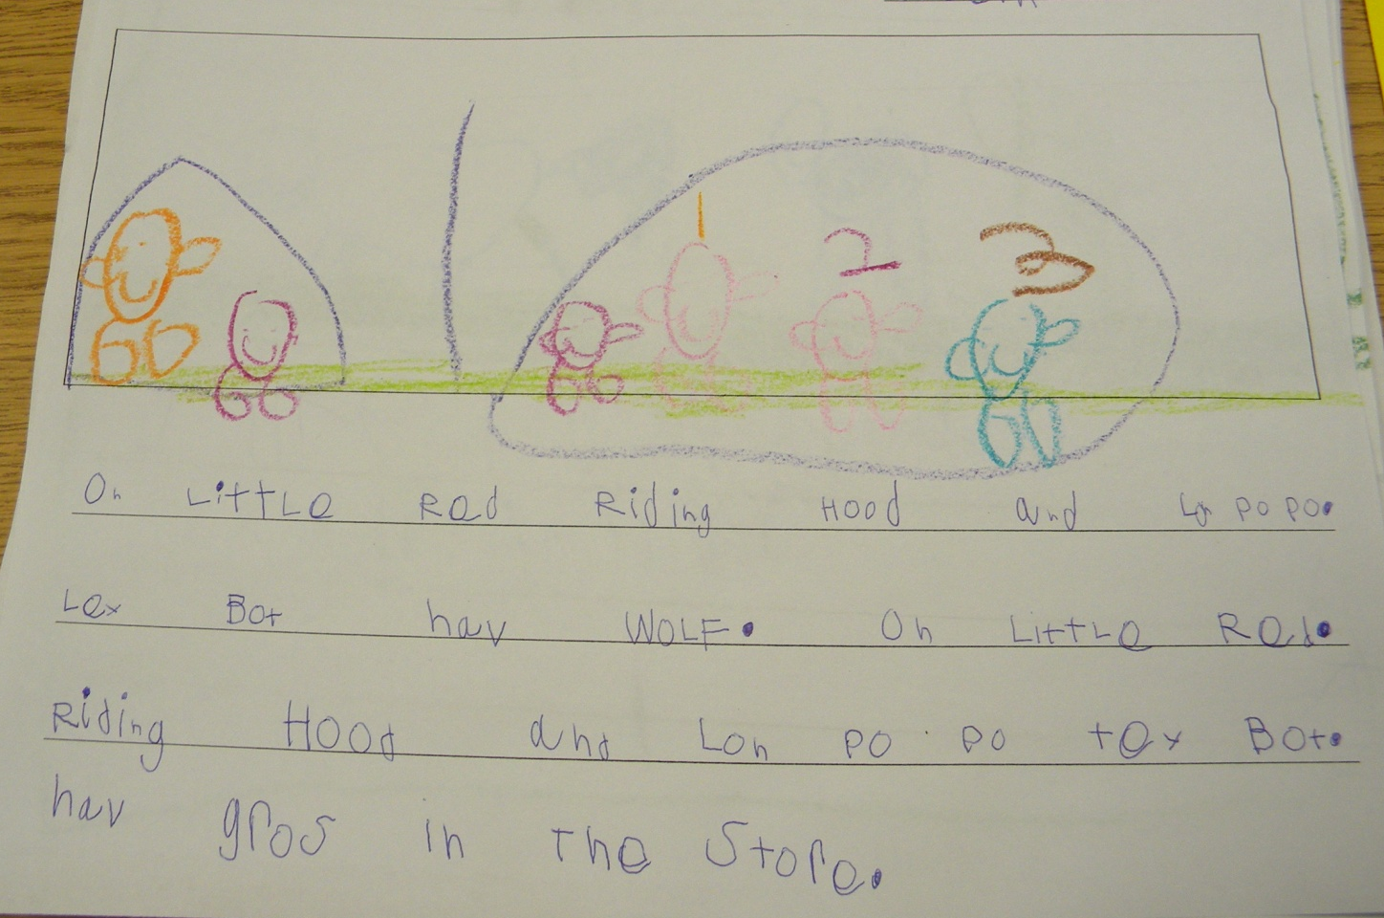
On Little Red Riding Hood and Lon Po Po
they both have wolf. On little Red
Riding Hood and Lon Po Po they both
have grandmas in the story.

Slide 17
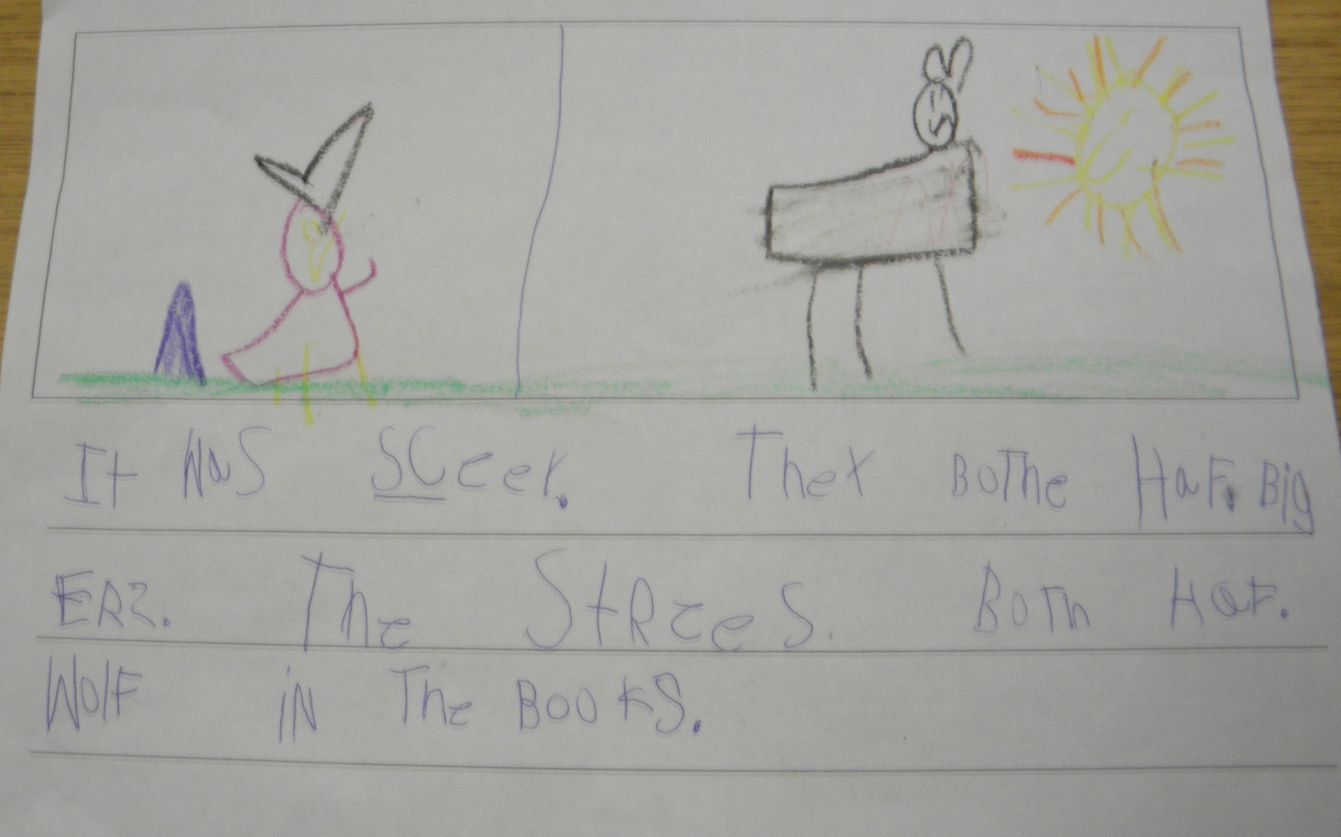
It was scary. They both have big
ears. The stories both have
wolves in the books.

Slide 18
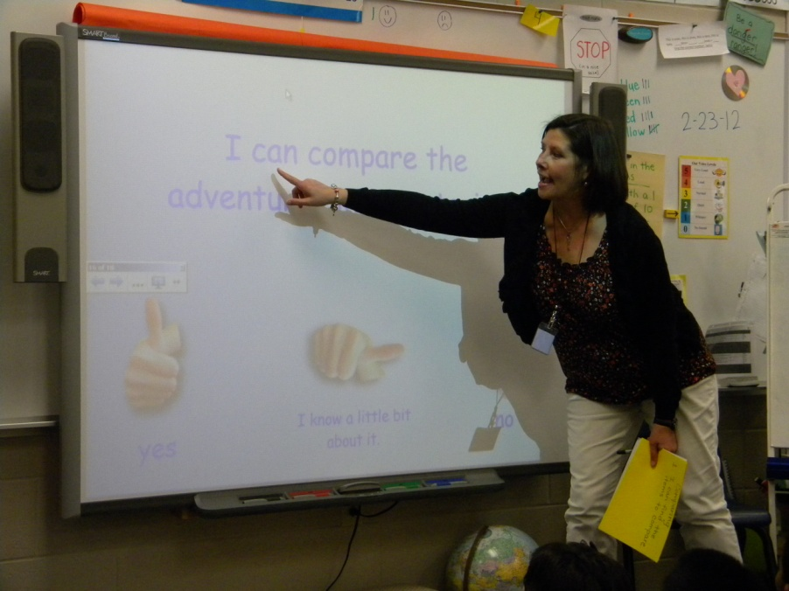
Goal:
I can compare the adventures in two stories.
Students revisited the goal and scored themselves with a thumbs up or down.
(8) Setting Objectives and Providing Feedback

Slide 19
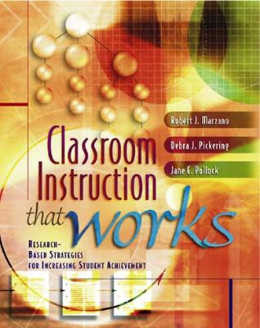
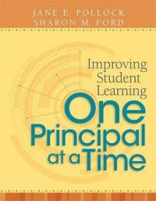
Marzano, R. J., Pickering, D. J., & Pollock, J. E. (2001). Classroom instruction that works: Research-based strategies for increasing student achievement. Alexandria, VA: Association for Supervision and Curriculum Development.
Pollock, J. E. (2007). Improving student learning one teacher at a time. Alexandria, VA: Association for Supervision and Curriculum Development.
Pollock, J. E., & Ford, Sharon M. (2009). Improving student learning one principal at a time. Alexandria, VA: Association for Supervision and Curriculum Development.

